Slide 1
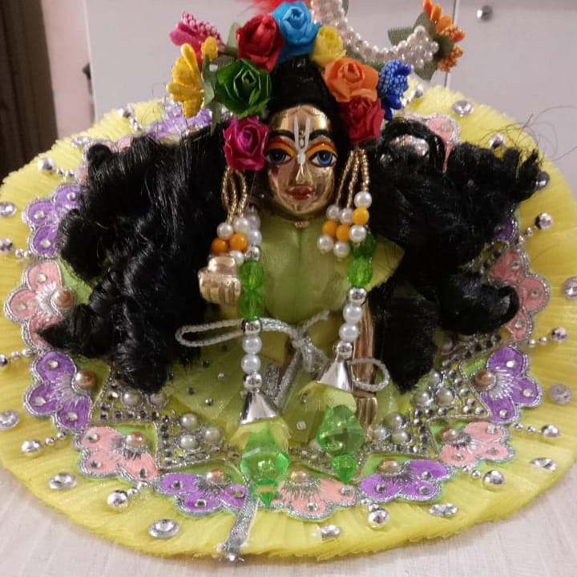
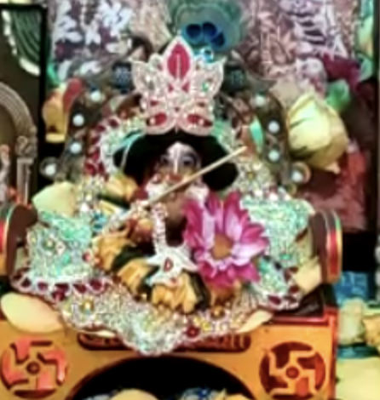
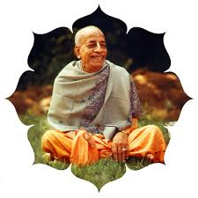
Welcoming Bal Gopal
New family member, most respectable and adorable Supreme Lord

Slide 2
Agenda
Importance of deity worship
How to take care of deity
Stories of deities and devotees
Amazing Pastimes Bal Gopal
Take home points

Slide 3
Devotional Service leads to perfection
śrī-bhagavān uvāca mayy āveśya mano ye māṁ nitya-yuktā upāsate śraddhayā parayopetās te me yukta-tamā matāḥ
śrī-bhagavān uvāca — the Supreme Personality of Godhead said; mayi — upon Me; āveśya — fixing; manaḥ — the mind; ye — those who; mām — Me; nitya — always; yuktāḥ — engaged; upāsate — worship; śraddhayā — with faith; parayā — transcendental; upetāḥ — endowed; te — they; me — by Me; yukta-tamāḥ — most perfect in yoga; matāḥ — are considered.
The Supreme Personality of Godhead said: Those who fix their minds on My personal form and are always engaged in worshiping Me with great and transcendental faith are considered by Me to be most perfect. [BG 12.2]

Slide 4
Devotional Service is easy
kleśo ’dhika-taras teṣām avyaktāsakta-cetasām avyaktā hi gatir duḥkhaṁ dehavadbhir avāpyate
kleśaḥ — trouble; adhika-taraḥ — very much; teṣām — of them; avyakta — to the unmanifested; āsakta — attached; cetasām — of those whose minds; avyaktā — toward the unmanifested; hi — certainly; gatiḥ — progress; duḥkham — with trouble; deha-vadbhiḥ — by the embodied; avāpyate — is achieved.
For those whose minds are attached to the unmanifested, impersonal feature of the Supreme, advancement is very troublesome. To make progress in that discipline is always difficult for those who are embodied.[BG 12.4]

Slide 5
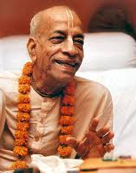
Prabhupada says: gyanis vs bhaktas
It is very difficult for him to simply theoretically understand that he is not the body. Therefore, the bhakti-yogī accepts the Deity of Kṛṣṇa as worshipable because there is some bodily conception fixed in the mind, which can thus be applied. Of course, worship of the Supreme Personality of Godhead in His form within the temple is not idol worship. There is evidence in the Vedic literature that worship may be saguṇa or nirguṇa – of the Supreme possessing or not possessing attributes. Worship of the Deity in the temple is saguṇa worship, for the Lord is represented by material qualities. But the form of the Lord, though represented by material qualities such as stone, wood or oil paint, is not actually material. That is the absolute nature of the Supreme Lord. [BG 12.4 p]

Slide 6
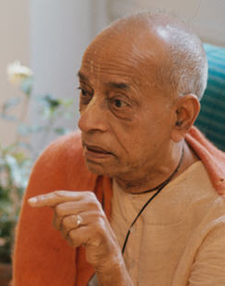
Mailbox Example
A crude example may be given here. We may find some mailboxes on the street, and if we post our letters in those boxes, they will naturally go to their destination without difficulty. But any old box, or an imitation which we may find somewhere but which is not authorized by the post office, will not do the work. Similarly, God has an authorized representation in the Deity form, which is called arcā-vigraha. This arcā-vigraha is an incarnation of the Supreme Lord. God will accept service through that form. The Lord is omnipotent, all-powerful; therefore, by His incarnation as arcā-vigraha He can accept the services of the devotee, just to make it convenient for the man in conditioned life. [BG 12.4 p]

Slide 7

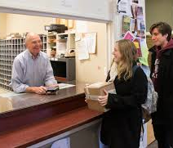
Mailbox = Postal Department

Slide 8
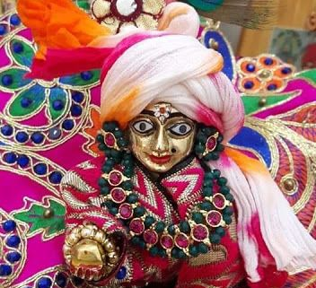
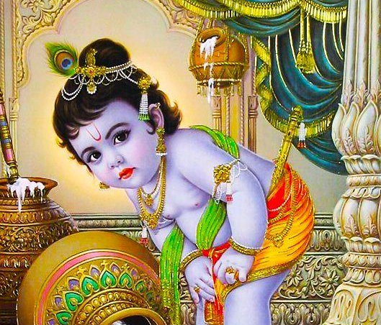
arcā-vigraha = Bal Gopal

Slide 9

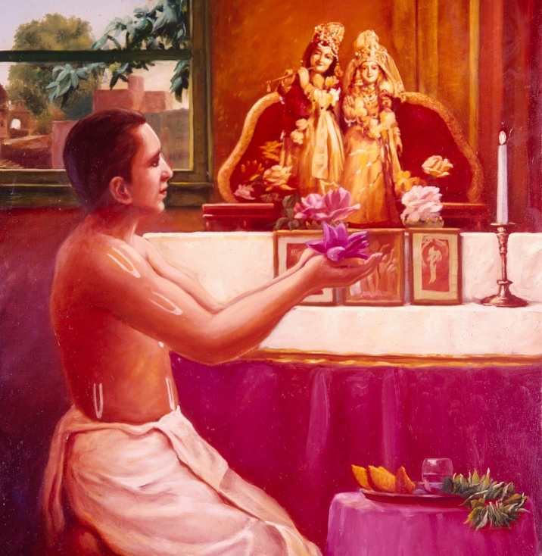
Taking Care of Bal Gopal – with LOVE
Welcoming with love and respect a new family member
Lord the real owner, we are His servants
Mangal Aarati Respect
Respect/Glorify/Praise
Japa
Increase attraction towards Krishna
Swadhyaya
Realize the presence of the Lord
Offering Bhoga
Offering food with love [BG 9.26]
Talking/Sharing
Share your experience and seek guidance
Bathing/Dressing
Bathe and dress the deities regularly.
Singing
Sing nice bhajans/kirtans

Slide 10
Lord accepts only when offered with LOVE
patraṁ puṣpaṁ phalaṁ toyaṁ yo me bhaktyā prayacchati tad ahaṁ bhakty-upahṛtam aśnāmi prayatātmanaḥ
patram — a leaf; puṣpam — a flower; phalam — a fruit; toyam — water; yaḥ — whoever; me — unto Me; bhaktyā — with devotion; prayacchati — offers; tat — that; aham — I; bhakti-upahṛtam — offered in devotion; aśnāmi — accept; prayata-ātmanaḥ — from one in pure consciousness.
If one offers Me with love and devotion a leaf, a flower, a fruit or water, I will accept it.[BG 12.4]
The important element, in preparation, in serving and in offering, is to act with love for Kṛṣṇa.

Slide 11
Advantage of Deity Worship with Love
Direct service to Lord leading to highest perfection in life
Lord accepts the services when offered with affection [BG 9.26]
Leads to liberation from bondage of work [BG 3.9]
Enter the kingdom of God bhaktyā mām abhijānāti [BG 18.55]
Simple and easy process; Can be done by rich or poor alike

Slide 12
Spiritual Progress
Two types of bhakti – raga or sadhana bhakti
full attachment in love to the Supreme
regulative principles
Two processes
Direct: Devotional Service in Krishna Consciousness
Indirect:
Perform Duty Selflessly >> Knowledge >> Meditation >> Understand Krishna

Slide 13
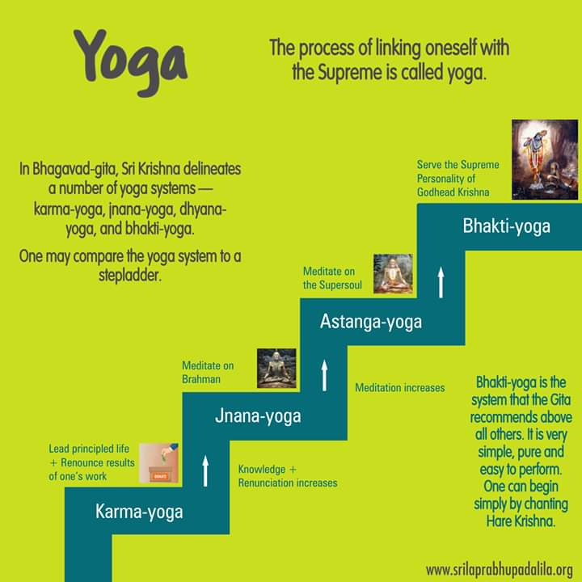
Yoga Ladder
mayy eva mana ādhatsva mayi buddhiṁ niveśaya
abhyāsa-yogena >> mām icchāptuṁ
mat-karma-paramo bhava / kartuṁ mad-yogam āśritaḥ >> siddhim avāpsyasi
sarva-karma-phala-tyāgaṁ
Fix your mind upon Me without deviation [12.8]
Follow the regulative principles of bhakti-yoga >> develop a desire to attain Me [12.9]
Try to work for Me >> come to the perfect stage [12.10]
Act giving up all results of your work >> be self-situated [12.11]

Slide 14
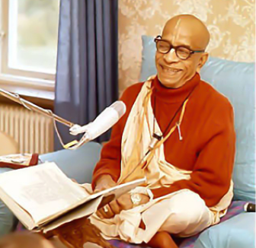
Regulative principle leads to love of God
To practice the regulative principles of bhakti-yoga one should, under the guidance of an expert spiritual master, follow certain principles: one should rise early in the morning, take bath, enter the temple and offer prayers and chant Hare Kṛṣṇa, then collect flowers to offer to the Deity, cook foodstuffs to offer to the Deity, take prasādam, and so on. There are various rules and regulations which one should follow. And one should constantly hear Bhagavad-gītā and Śrīmad-Bhāgavatam from pure devotees. This practice can help anyone rise to the level of love of God, and then he is sure of his progress into the spiritual kingdom of God. This practice of bhakti-yoga, under the rules and regulations, with the direction of a spiritual master, will surely bring one to the stage of love of God. [BG 12.9 p]

Slide 15
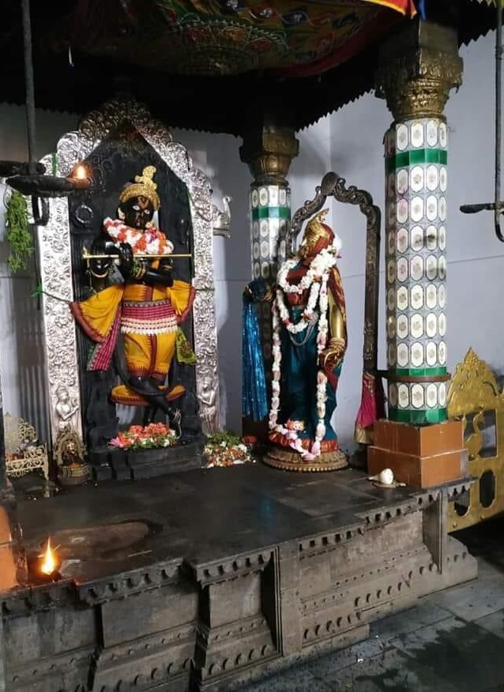
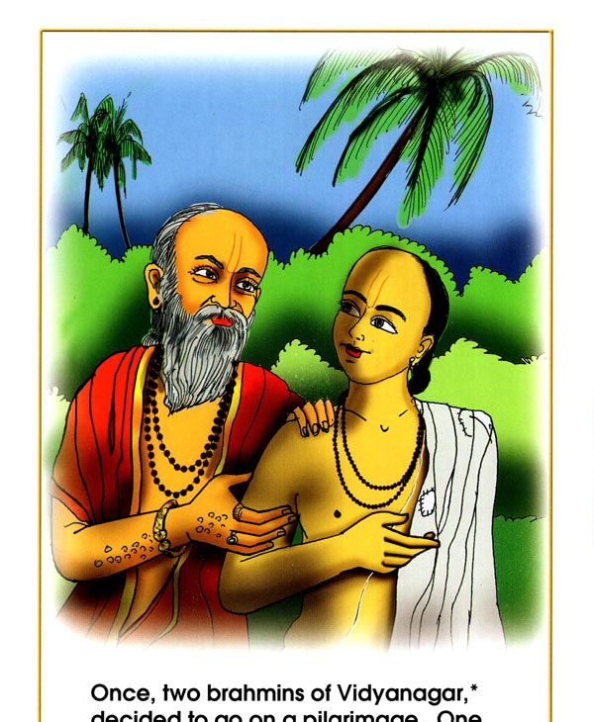
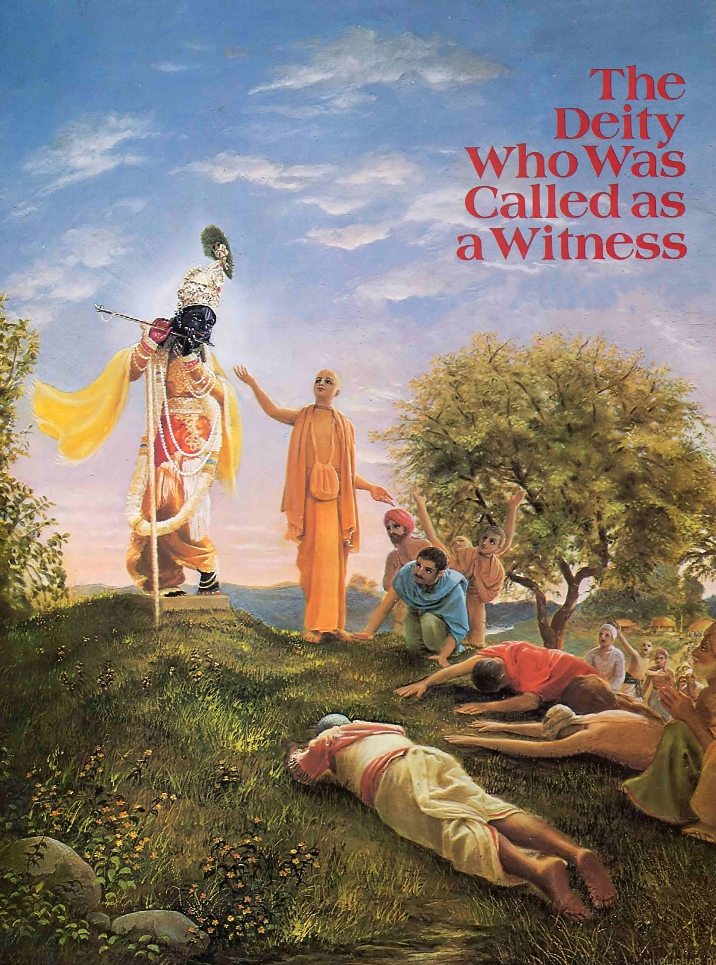
Sakshi Gopal
Once there were two Brahmins (priests) from Vidyanagara in South India, who decided to make a long tour of the various holy places of pilgrimage in Northern India.
One was rich & old other poor & young
Two pilgrims reached Vrindavana
The beauty of the Gopala Deity stole away their minds
Younger brahmin served older one.
Elderly Brahmin was so grateful – offered daughter
Later due to social obligations old brahmin remained silent
Younger brahmin goes and talks to Gopal CC.M.5.97

Slide 16


Slide 17
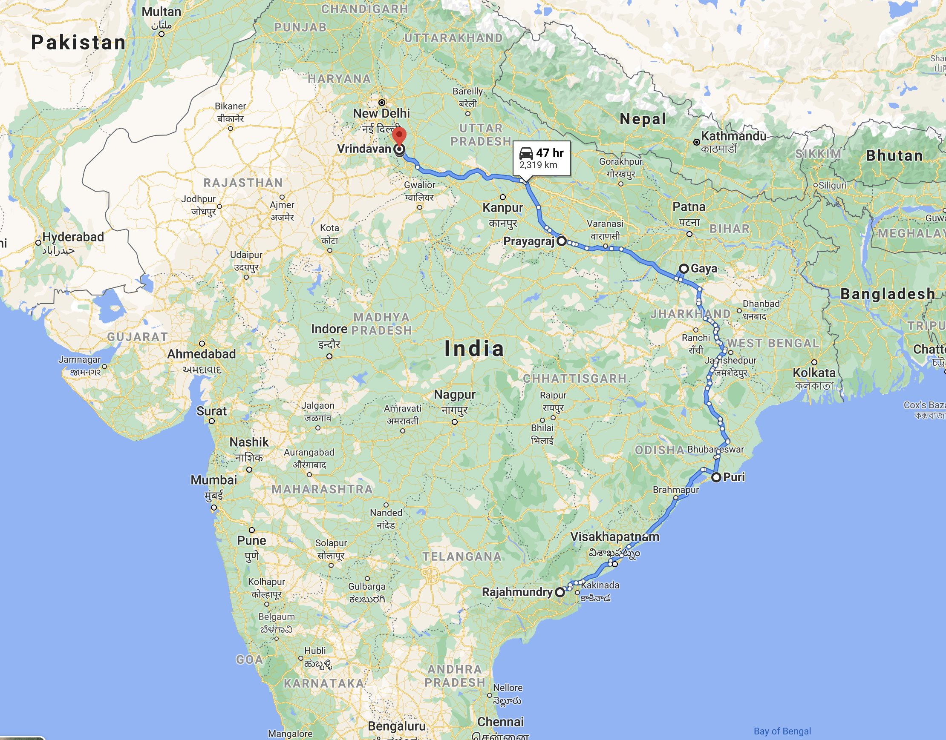
Vidyānagara to Vṛndāvana (1440 mi)

Slide 18
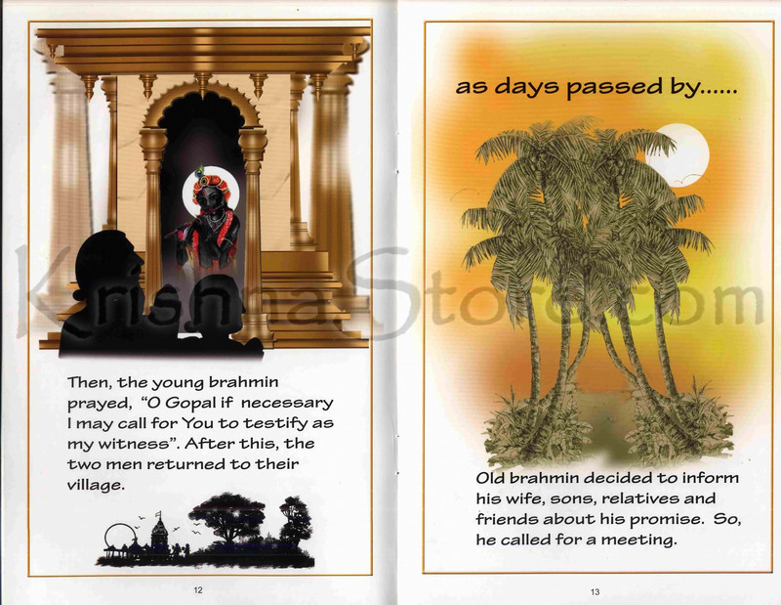

Slide 19


Slide 20
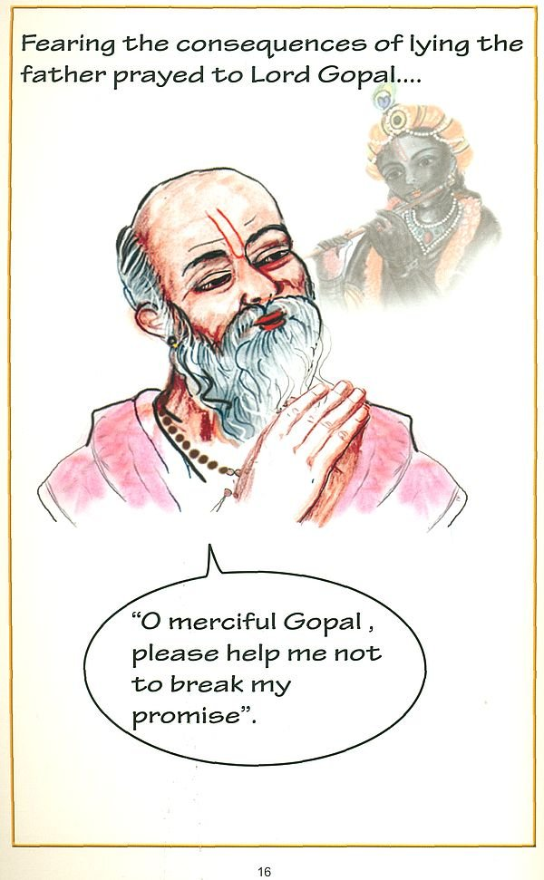

Slide 21
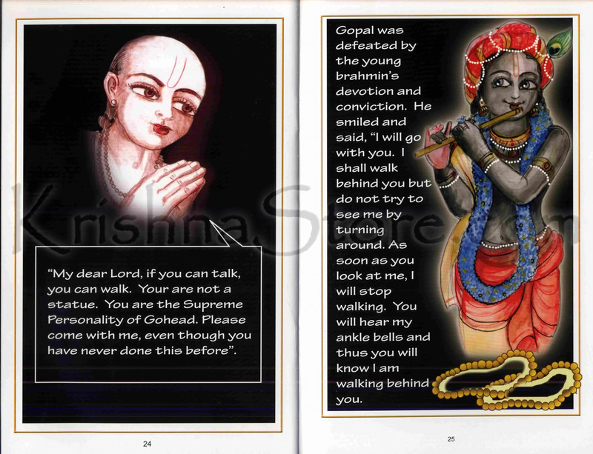

Slide 22
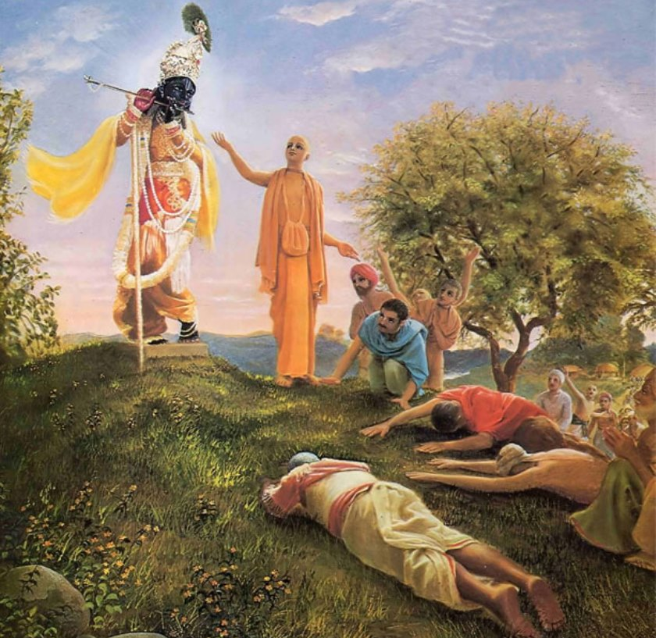

Slide 23
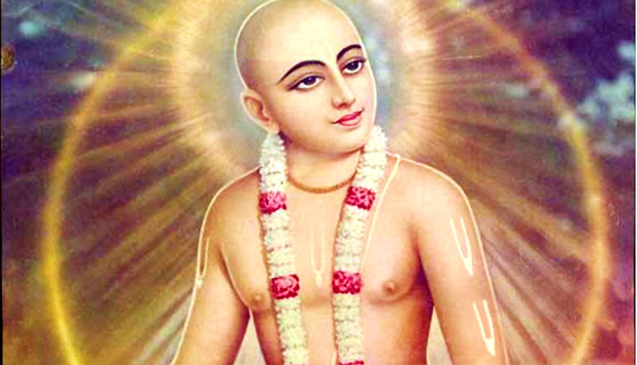
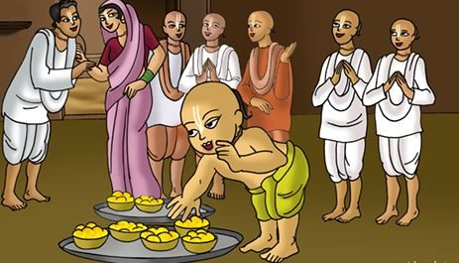
Other pastimes
Lord Chaitanya took pleasure hearing story of Sakshi Gopal from Nityananda prabhuji at the Sakshi Gopal temple in Katak
Queen of Puruṣottama-deva wished to give Gopalji a valuable nose pearl
Lord Chaitanya eats away offering of the Brahmin
The tale of two marble stones – Tapa is needed

Slide 24
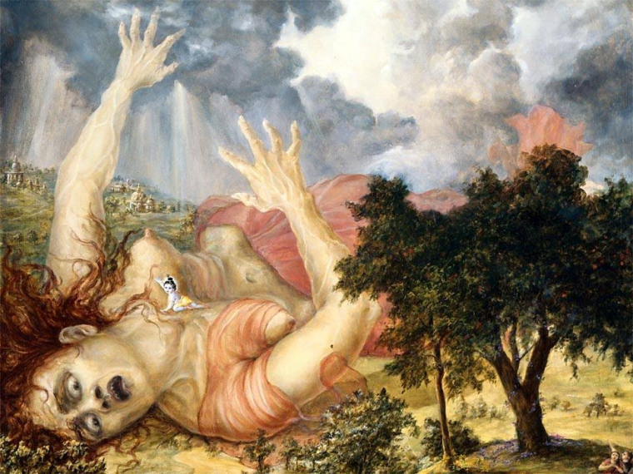
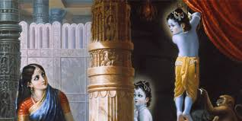
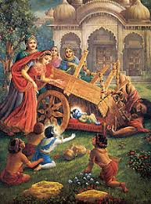
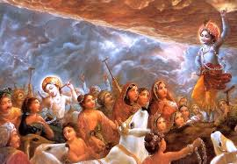
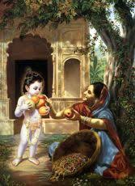
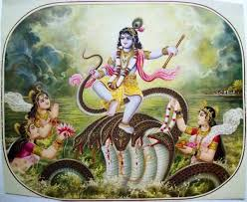
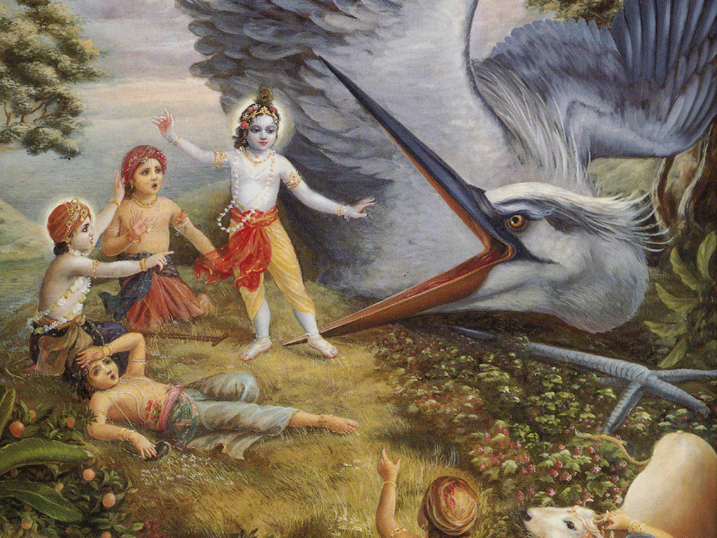
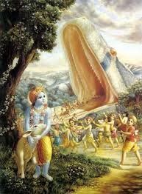
Bal Gopal Pastimes

Slide 25
Bal Gopalji ki Jai – Lessons learned
Lord mercifully manifests in deity form
There in no difference between Supreme Lord and Bal Gopal deity
Deity form of Lord accepts and reciprocates - He can talk and walk
Need to be pure and faithful, humble and obedient
Need to follow the regulative principles of bhakti to purify
MA, Japa, Reading BG/SB/CC
Serve the deities with love and respect
Smile at all others ☺
If we are not grateful, we are great fools !!! ☺

Slide 26
Welcoming Bal Gopal
New family member, most respectable and adorable Supreme Lord

